Slide 1
HireAC
YOUR HOW TO GUIDE

Slide 2
HireAC Guide Sections
Getting Started with HireAC
Cooperative Education Module in HireAC
Changing Preferred Name in HireAC
Downloading the Co-op Work Permit Confirmation Letter
Co-op Documents Page in HireAC
Co-op Job Postings Page in HireAC
Setting up Job Alerts in HireAC
Co-op Interviews Page in HireAC
Co-op Job Offers in HireAC
Co-op Work-term record in HireAC
Booking a Peer Review meeting in HireAC
Events And Workshops Module in HireAC
Career & Employment Module in HireAC

Slide 3
13. Career & Employment Module in HireAC
View and Apply for Full-time, Part-time, and Summer Jobs in a Variety of Industries

Slide 4
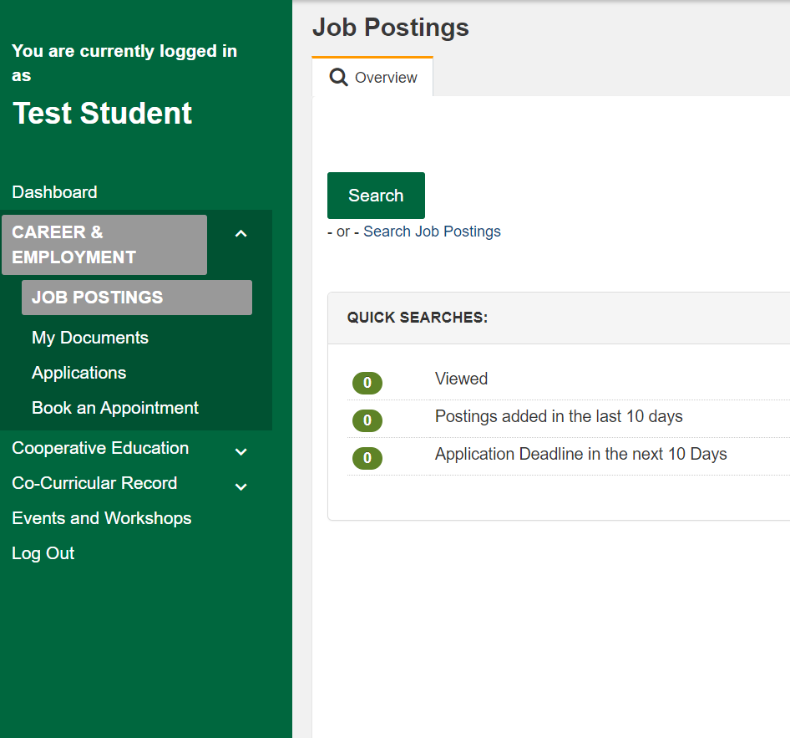
Career & Employment Module in HireAC
Go to the Career & Employment module
Select Job Postings to view jobs that are open to all Algonquin College students.
These jobs are full-time, part-time, and summer employment postings in a variety of industries and career fields
Access on-campus CSEP (College Student Employment Program) positions that are part of Algonquin’s Work Study Program.
The options in the Quick Searches menu will show you the number of jobs that you have viewed, new postings and those that will be closing soon.
4

Slide 5
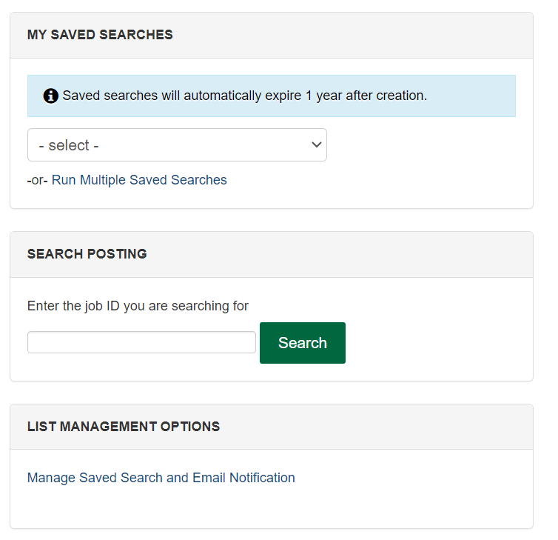
Searching jobs using the Career & Employment module
You can create tailored saved searches
Search for jobs by Job ID
Manage your list of saved search and email notifications.
1
2
3
5

Slide 6
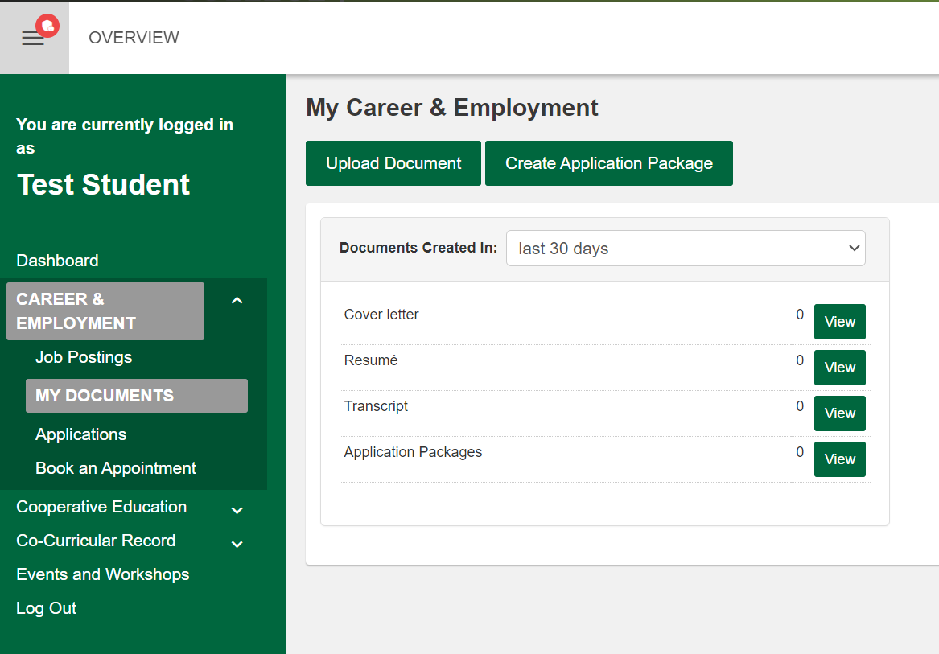
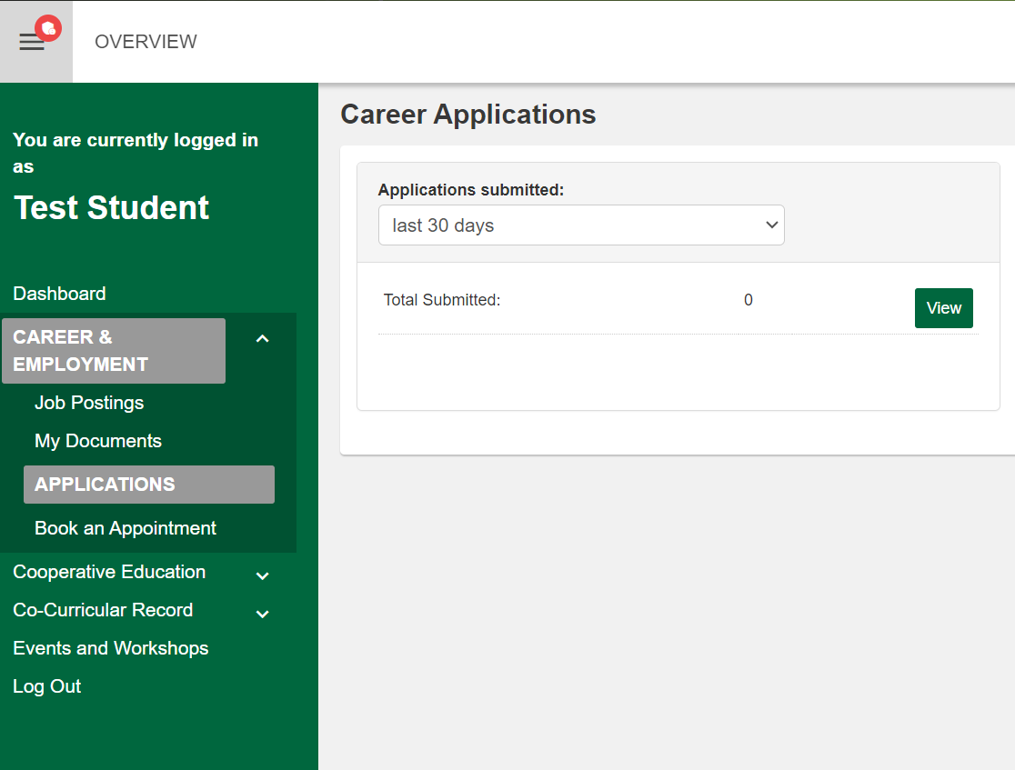
Documents and Job Applications
Use the Documents and Applications pages to upload your resumes and cover letter, submit and track your job applications.
Application method preferred by the employer will be listed in the job posting.
Most of the jobs posted in the Career & Employment module of HireAC will require you to apply for opportunities using the employer website.
6

Slide 7
Book an Appointment with a Career Advisor
Receive support in your post-Co-op career search by accessing the job and career readiness support and resources for students and graduates with the Student Support Services.
Access online and in-person career services to learn how to increase your employability skills and make meaningful connections with employers.
To book an appointment with a Career Advisor please visit: Book a Career Advising Appointment

